Slide 1

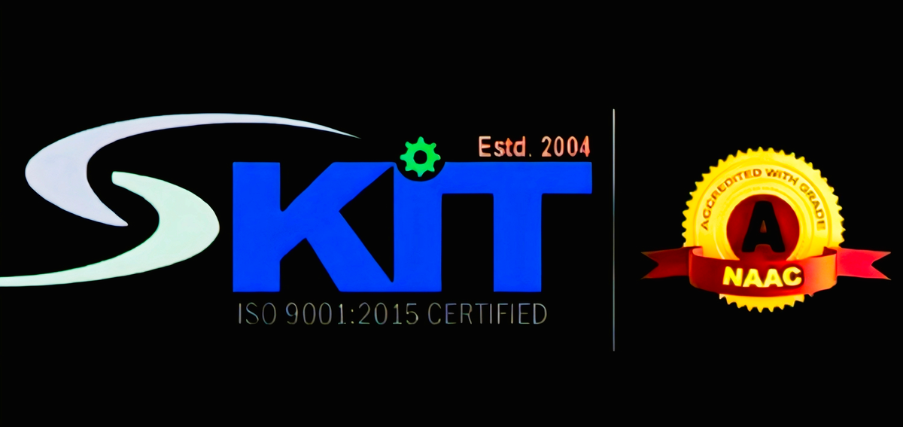




AVOTHIC 2.0
HACKZENITH
team lead - saurabh kumar
members- bhavya bharadwaj
rajat jain
shubham tiwari
category- software
Exploring innovations that will shape our world tomorrow.
page 01

Slide 2
HackZenith
An all-in-one AI platform that instantly converts any video into multiple Indian languages with real-time subtitles and natural dubbing, making digital education truly accessible for all.
# Core Features:
→ Instant Multilingual Conversion: Convert any video into 22+ Indian languages.
→ Accurate Subtitles: Auto-generates perfectly synced subtitles.
→ Human-like Dubbing: Creates natural, high-quality voiceovers. Contextual AI → → Translation: Intelligently protects technical terms & cultural nuances.
→ Real Time Speed: Instantly localizes both live and recorded content.
LEKSIKOVOX
LeksikoVox
page 02

Slide 3
HackZenith
PROBLEM
SOLUTION
In India, a significant language barrier currently excludes over 88% of students from accessing high-quality digital skill courses, which are predominantly in English. Manual localization is prohibitively expensive, slow, and often fails to capture the contextual accuracy required for technical education.
LeksikoVox is an AI-based multilingual translation platform designed to bridge India's language gap by providing real-time transcription, translation, and voice synthesis in over 22 Indian languages.
Built on scalable, open-source AI models, it features a Smart Contextual Engine for accurate technical translation and an AI Quiz Generator for interactive learning.
Its goal is to make digital education accessible, inclusive, and contextually precise for all Indians, supporting government initiatives like NEP 2020 and Skill India.
LeksikoVox
page 03

Slide 4


HackZenith
TECHNICAL APPROACH
1.
2.
Backend
(Engine & Logic)
3.
AI/ML Core
(The Brains)
4.
Frontend
(User Experience)
Cloud & Deployment
Python & FastAPI
→ High-speed APIs for the core pipeline.
WebSockets
→ Powers real-time streaming.
Firebase
→Real-time data storage
OpenAI Whisper
→ Accurate Speech-to-Text (ASR).
AI4Bharat IndicTrans2
→ Best-in-class Indian language translation.
ElevenLabs API
→ Natural, human-like voice generation (TTS)
Custom Glossary
→ Protects technical terms.
Quiz Generation
→ A Large Language Model (LLM) to auto-generate assessments from the translated text
React.js & Video.js
→ Dynamic UI with a multilingual player.
Figma → Prototyping & design.
AWS / GCP
→Scalable cloud hosting.
Docker & GitHub Actions
→ Easy deployment & automation (CI/CD).
LeksikoVox
page 04

Slide 5
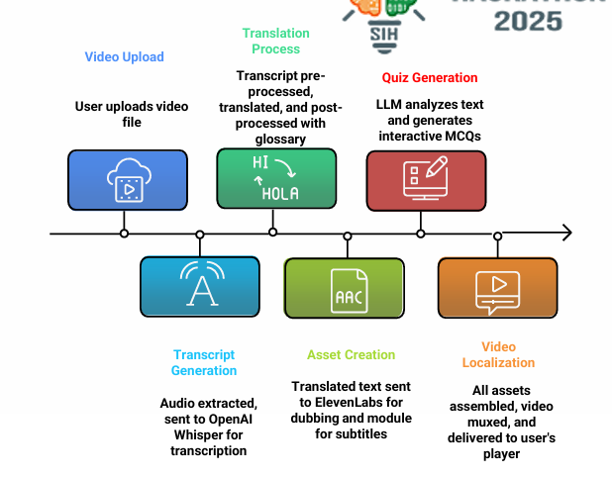

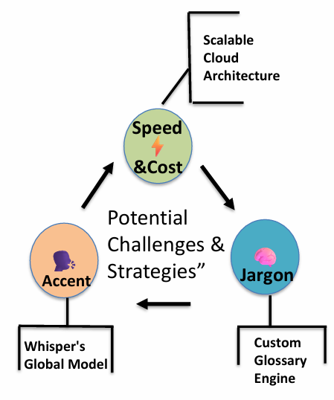
HackZenith
WORKING / PROCES
LeksikoVox
page 05

Slide 6
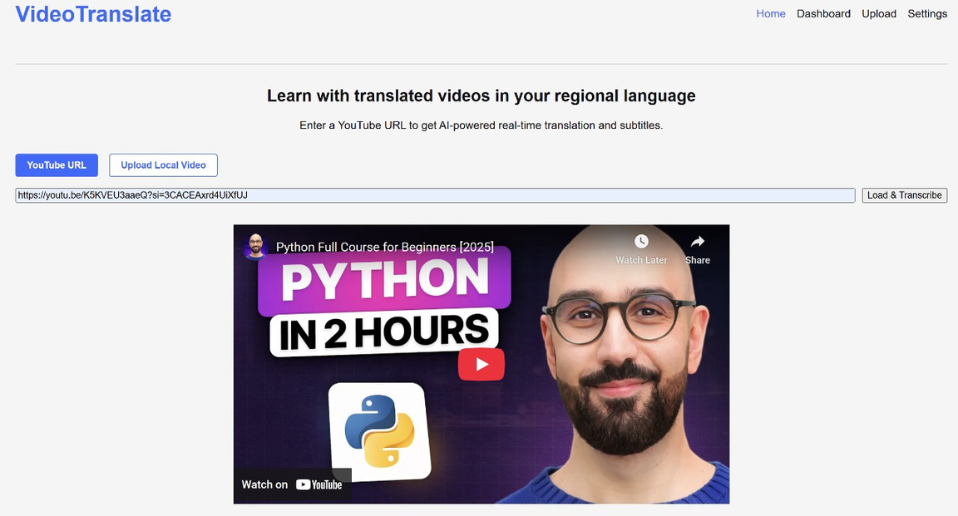
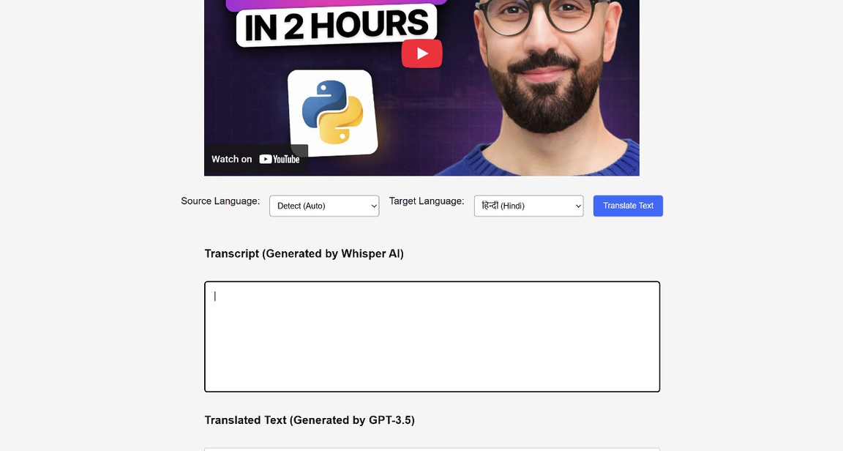
HackZenith
RESULTS
LeksikoVox
page 06

Slide 7
hackzenith
THANK YOU!
As we look to the future, this technology will play a crucial role in shaping a better world for generations to come.
LeksikoVox
page 07

